Slide 1
Z-Voting
Developer: Amir Ekbatanifard
Mail: amirekbatani75@gmail.com
GitHub: www.github.com/AMIRKHANEF

Slide 2
Z-Voting
A Complete anonymous Voting framework
Using zero-knowledge proof
Private Voting
Implement in smart contract (SOLIDITY)
Upgradeable
Can be used on any blockchain that supports solidity smart contracts
High security
Can be used on main net
Reusable
11

Slide 3
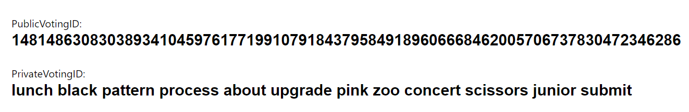
Privacy
Public VotingID
Private VotingKey (for signing)
Every voter must have:
Private Voting KEY
(mnemonic)
Public Voting ID
Pedersen Hash
12

Slide 4
Security
Powerful zero-knowledge proof
Immutable verifier
Merkle tree of voters
LEAF = Public Voting ID
13

Slide 5
Implementation

Slide 6
14

Slide 7
Let’s see a demo

Slide 8
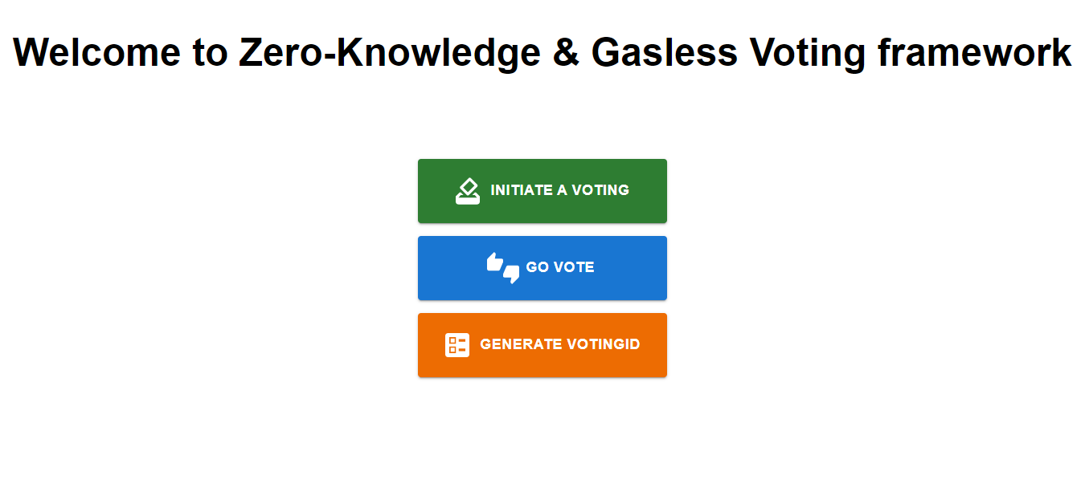

Slide 9
Generate a VotingID

Slide 10
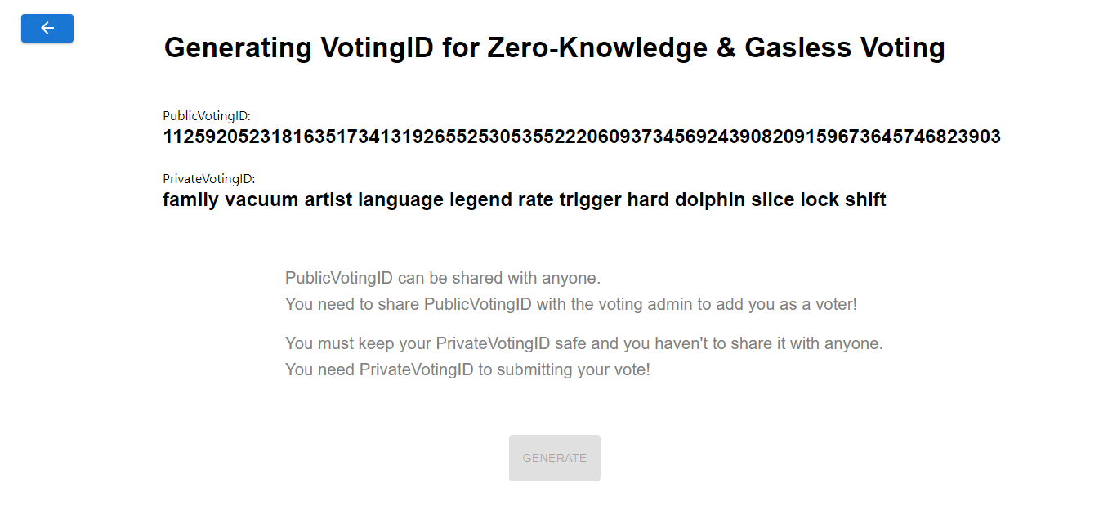

Slide 11
Initializing a voting

Slide 13
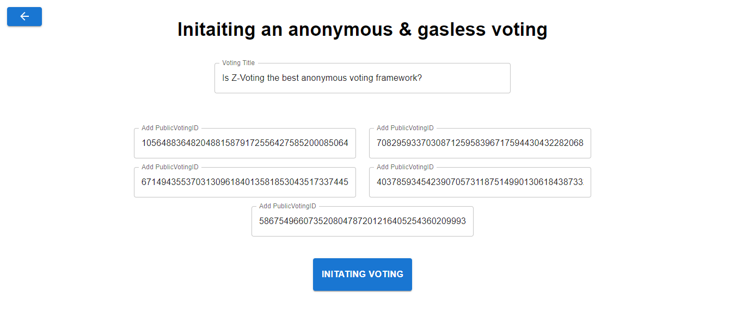

Slide 14
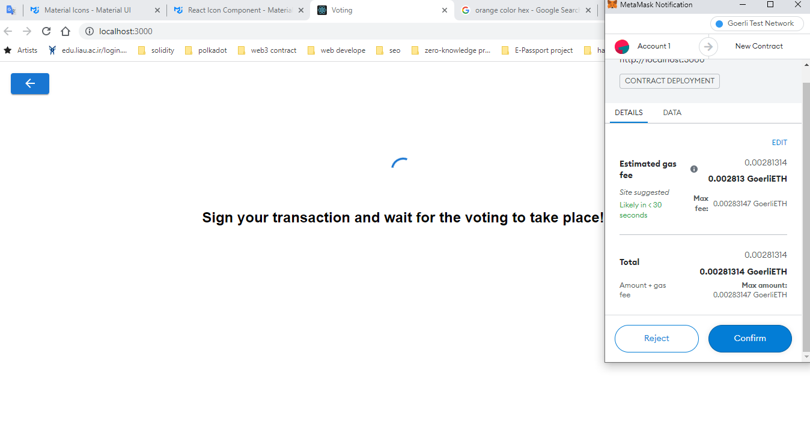

Slide 15
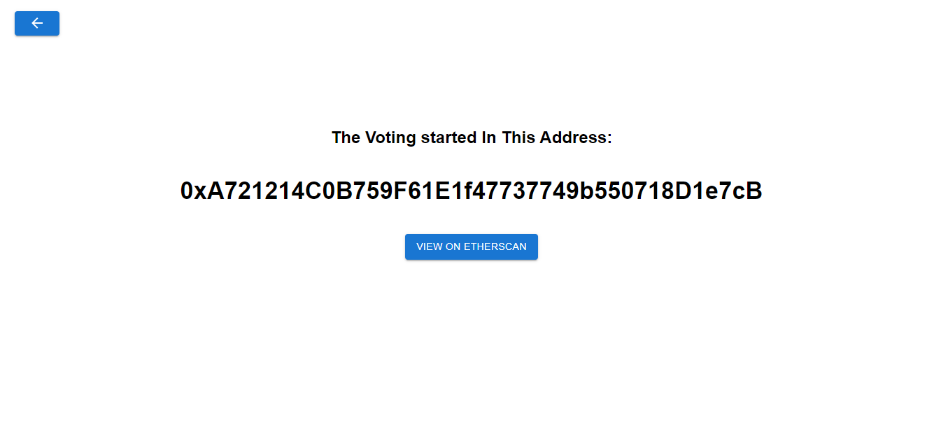

Slide 16
Vote

Slide 18
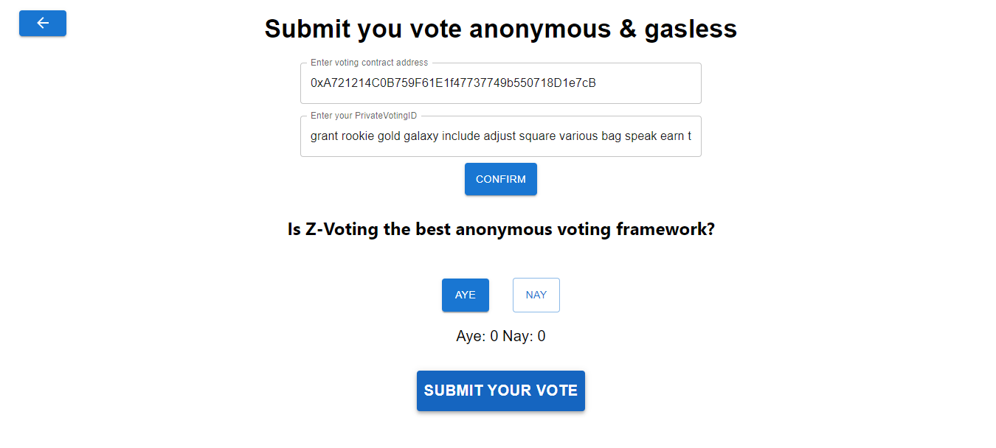

Slide 19
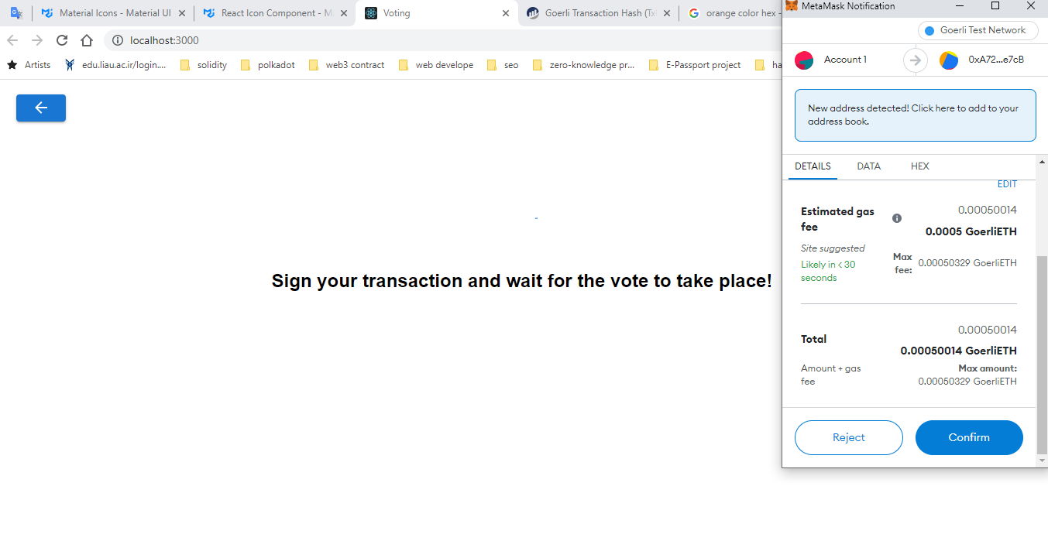

Slide 20
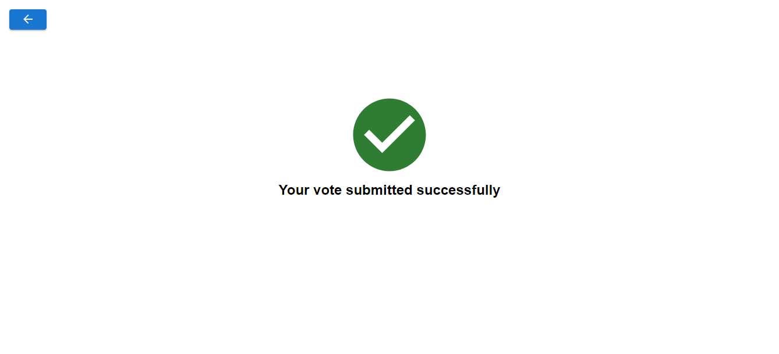

Slide 21
Thanks for your attention

Slide 22
